Slide 1
REGISTRATION
&
ORIENTATION
2016-2017
Emily Wade, OnRamps Product Manager

Slide 2
PART 1: Registration

Slide 3
Aug 22 – Sep 9
Course Enrollment
Students register for OnRamps course on the OnRamps Student Portal website.
Registration is facilitated by the Instructor in the high-school classroom.
After Sep 9, student must obtain permission from UT Instructor of Record to enroll.
After Sep 9, Instructor must request student withdrawal if student leaves their classroom.

Slide 4
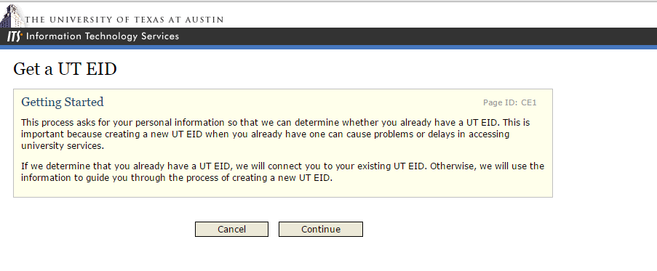
Enrollment Step 1: Create EID
Student creates UT EID and password on UT Austin website: https://idmanager.its.utexas.edu/eid_self_help/
A student who already has a UT EID should not create a new one. There are tools on the UT Austin website to help students find an existing EID or reset their password.

Slide 5
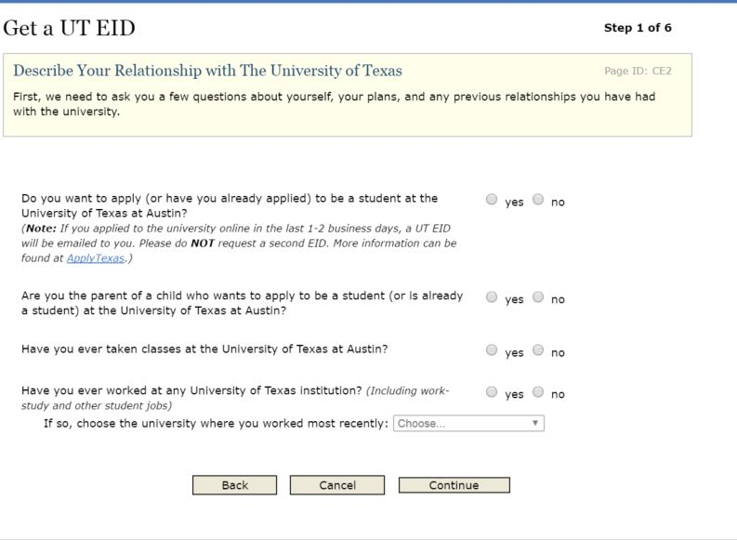
Create EID
Student answers each question.
If unsure, student should answer No.

Slide 6
Create EID

Slide 7
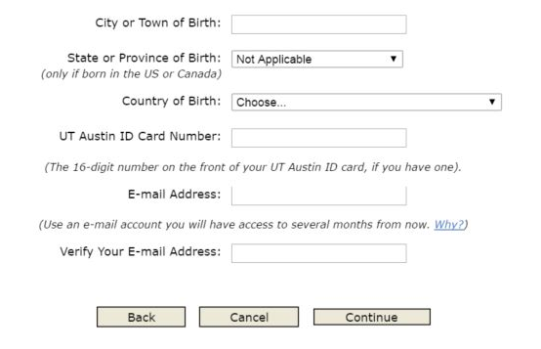
Create EID
Remind students to include their e-mail address!
E-mail address is REQUIRED for official UT enrollment & credit.

Slide 8
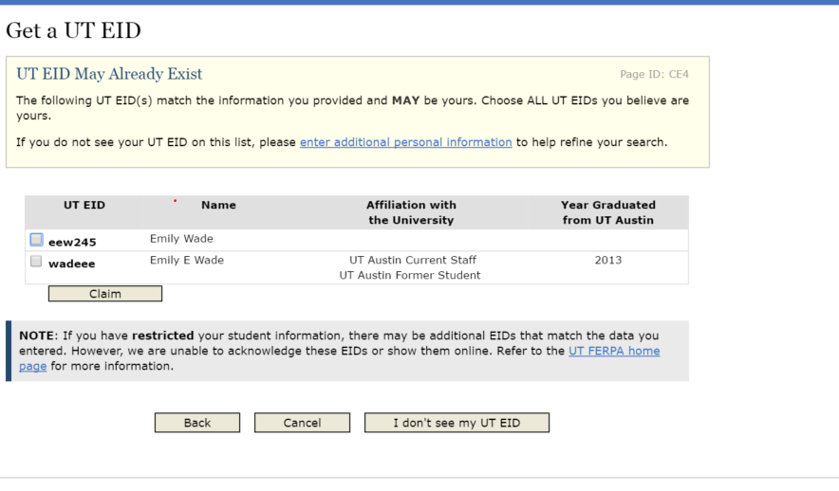
Create EID
If student already has an EID, claim it!
A student who already has an EID should not create a new one.

Slide 9
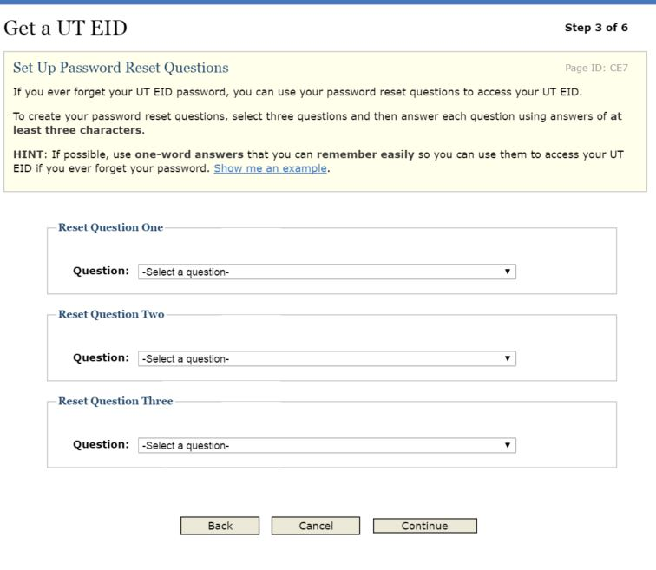
Create EID
Student selects three Password reset questions and answers.

Slide 10
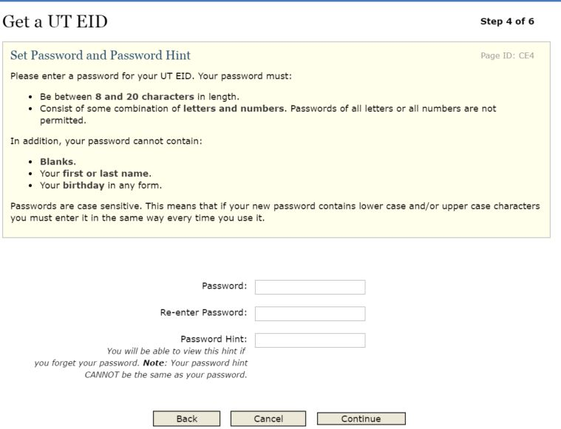
Create EID
Student creates a Password.
See Password Requirements on the next slide.
A sufficiently strong password is REQUIRED for official UT enrollment & credit.

Slide 11
EID Password Requirements
must be between 8 and 20 characters in length
must contain letters, numbers, and special characters. The special characters that are permitted are ! @ # $ % & * ( ) - + = , < > : ; " ' ..
may not match any of the last 10 passwords
cannot contain blanks
cannot contain the UT EID
cannot contain the first or last name.
cannot contain the birthday in any form.
cannot contain any words found in our dictionary or common proper nouns of four letters or longer. In addition, common letter transpositions are not allowed (for example @ for a, ! for i, or zero for O).

Slide 12
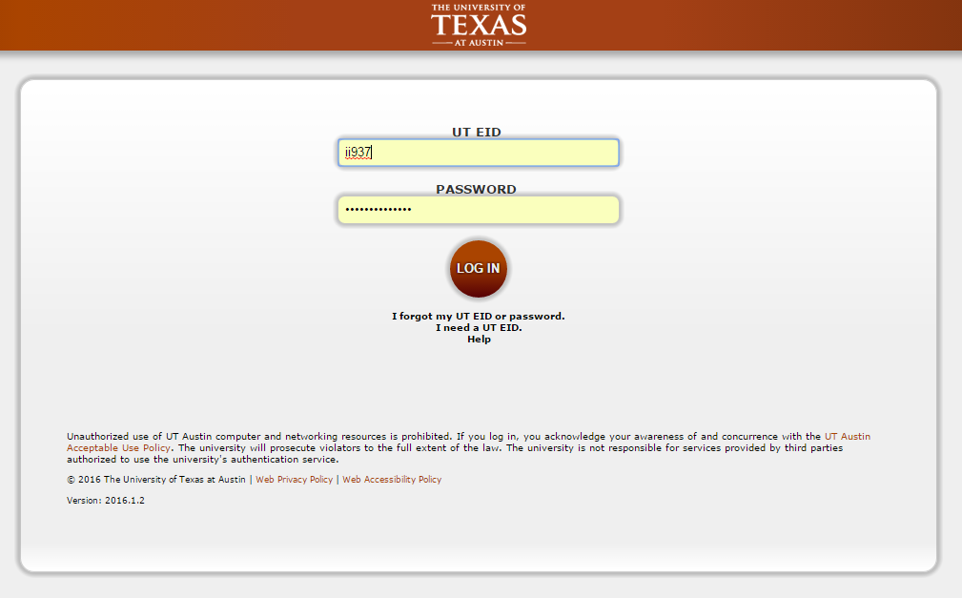
OnRamps Student Portal
After EID is created, students use their EID and password to access the OnRamps Student Portal: https://utdirect.utexas.edu/apps/ce/osis/

Slide 13
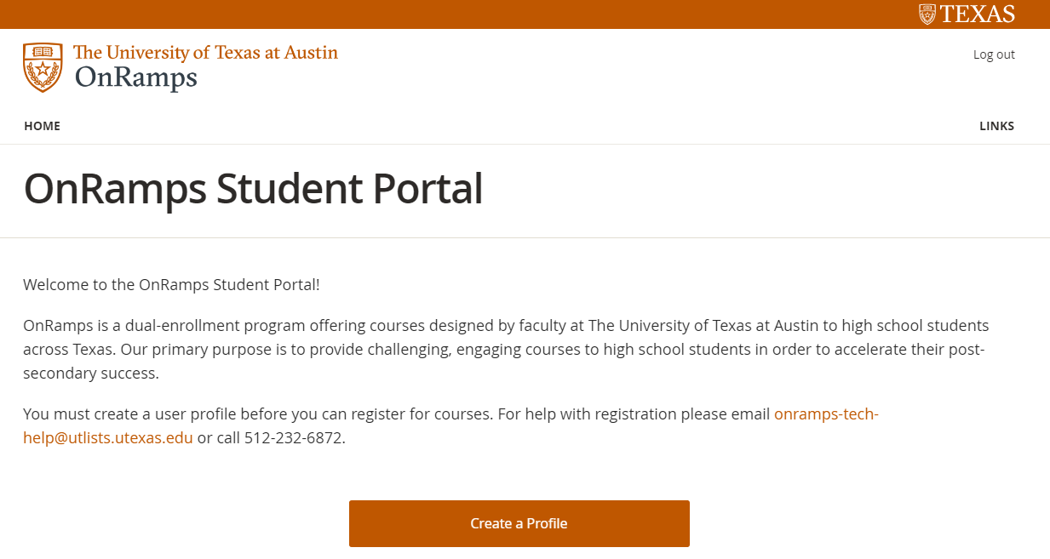
OnRamps Student Portal
Students click “Create a Profile” and create their OnRamps student profile.

Slide 14
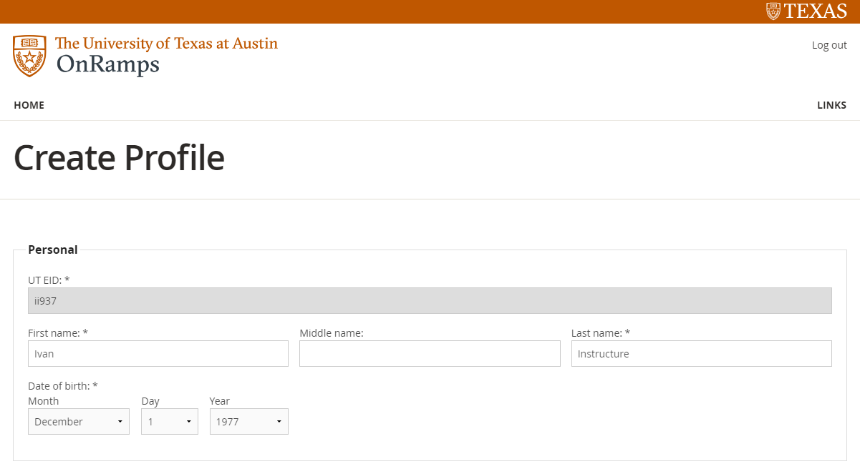
Enrollment Step 2: Create Profile
Students answer a series of demographics questions. Some information is pre-filled based on the student’s UT EID information. All fields are editable except the UT EID.

Slide 15
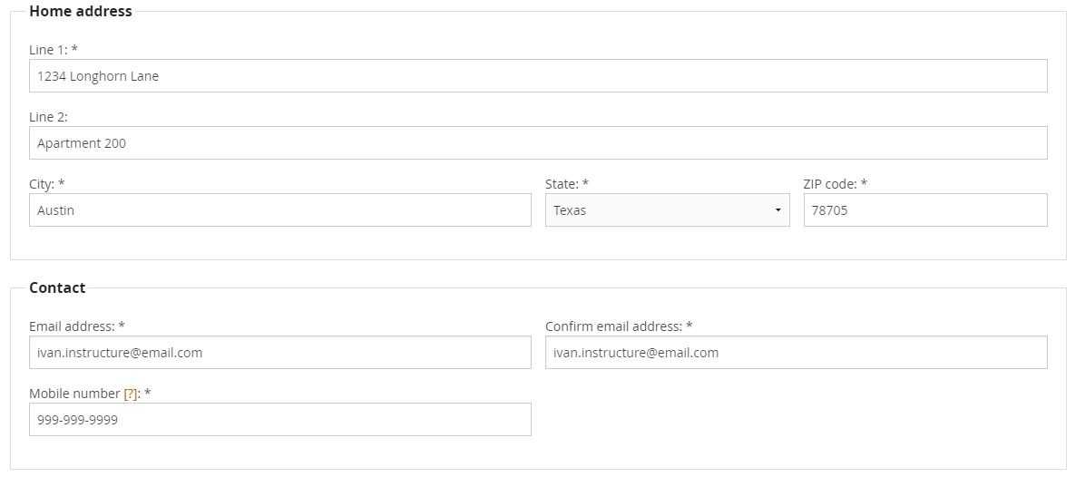
Create Profile

Slide 16
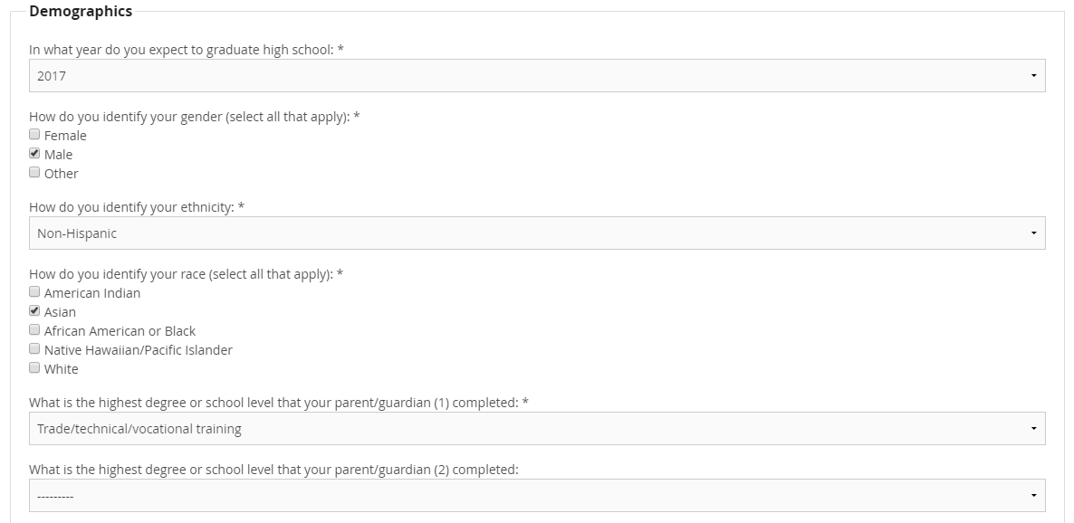
Create Profile

Slide 17
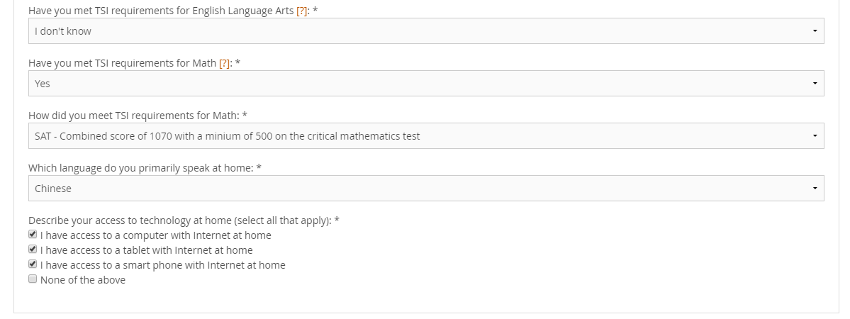
Create Profile
Students will answer questions about meeting TSI requirements. Students who select Yes will be prompted to select how they met requirements. Students who select No or I don’t know will not be further prompted.

Slide 18
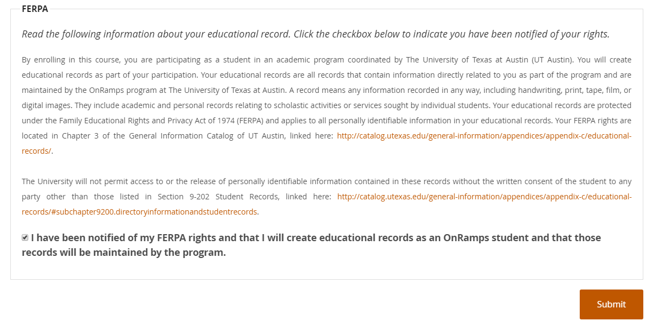
FERPA
The final step in creating a profile is reading a FERPA notification and selecting a checkbox indicating that the student has been notified of FERPA rights. Students will not be able to create a profile without selecting the checkbox.

Slide 19
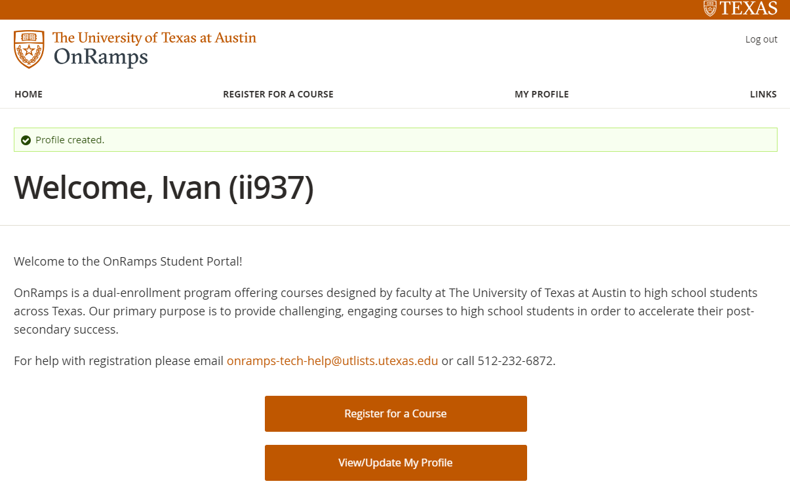
Enrollment Step 3: Registration
After students create a profile, they will be redirected to the Welcome page.
Students should click “Register for a Course” to register for their OnRamps Course.

Slide 20
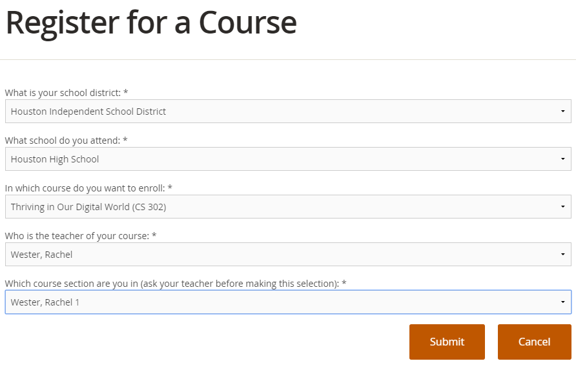
Registration
Student selects the appropriate District, Campus, Course, Instructor, and Section and clicks Submit.

Slide 21
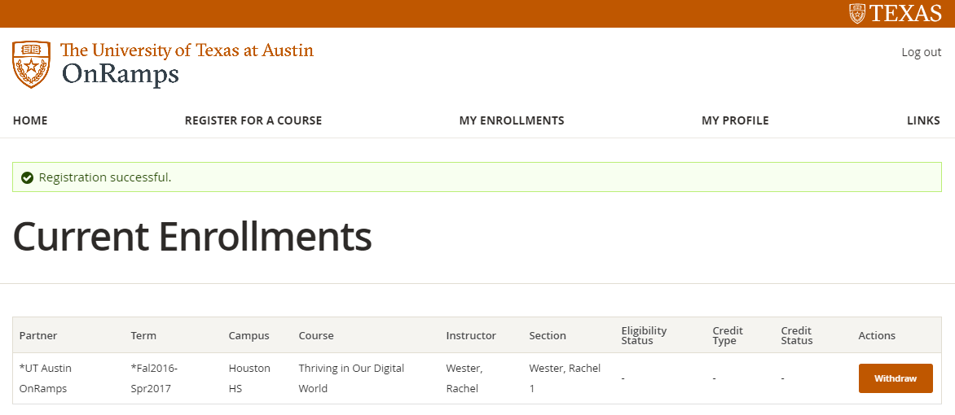
Registration
After clicking Submit, the student can review the enrollment on the Current Enrollments page.

Slide 22
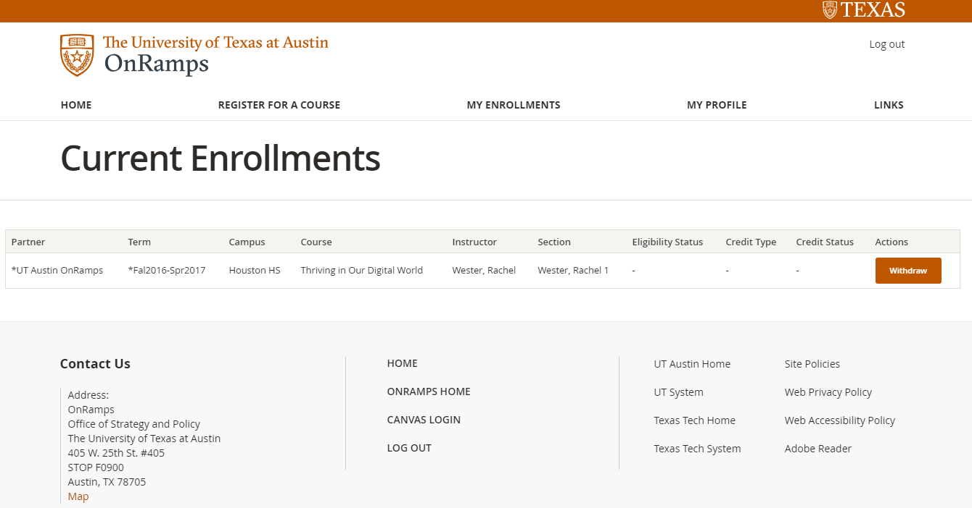
Enrollment Step 4: Accessing Courses in Canvas
Student clicks Canvas Login to access OnRamps Orientation and OnRamps Courses. The student will be automatically logged in to Canvas with their EID and password.

Slide 23
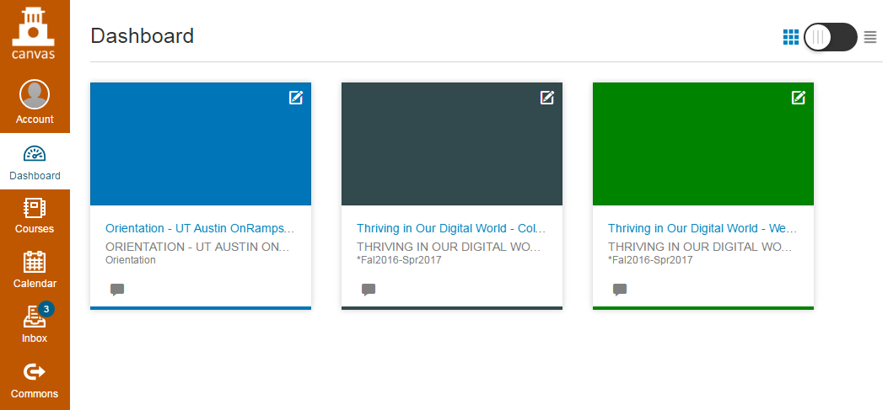
Accessing Courses in Canvas
Student’s OnRamps Orientation and OnRamps courses appear on the Canvas Dashboard.

Slide 24
PART 2: OnRamps Orientation

Slide 25
Orientation in Canvas
Student’s OnRamps Orientation is displayed separately from their other courses on the Canvas dashboard

Slide 26
Orientation Overview
Four modules delivered in Canvas course for all students participating in OnRamps
Delivered in first week, ideally in class
1% of college grade (completion)
Encouraged for high school grade

Slide 27
Orientation Overview
STEP 1
STEP 2
STEP 3
STEP 4

Slide 28
Step 1
When first accessing Orientation, students should click on STEP 1. They will NOT have access to STEP 2-4.
Students are required to complete Beginning of Course Assessment (STEP 1) before moving on to STEP 2-4.

Slide 29
Beginning of Course Assessment
To complete the Beginning of Course Assessment, student will need to click on the blue button on the first page of STEP 1

Slide 30
Beginning of Course Assessment
The Beginning of Course Assessment will open in a new tab in the student’s browser.
At the end of the questionnaire, students will be given an access code.
To access STEP 2-4, students will need to return to the Intro to Beginning of Course Assessment page (a link will also be provided at the end of the Beginning of Course Assessment) and should click “NEXT. ”

Slide 31
Step 1 Quiz
Students will be prompted to enter their access code the Beginning of Course Assessment Quiz.
The Beginning of Course Assessment Quiz is a one question quiz.
Students will be asked if they completed the Beginning of Course Assessment.
When they answer “yes,” they will be given access to STEP 2-4.

Slide 32
Step 2-4
Students will need to complete all quizzes in all steps to receive credit.
To monitor their progress, students can click on “modules” in the navigation bar to see what they have completed.
Green check marks will appear next to completed tasks. (see next slide).

Slide 33
Check Progress in Modules

Slide 34
Additional Information
For additional information on OnRamps orientation, consult the Instructor’s Guide .

Slide 35
Questions?
Contact your Course Coordinator or
Emily Wade
eewade@austin.utexas.edu
512.232.1771

